Slide 1
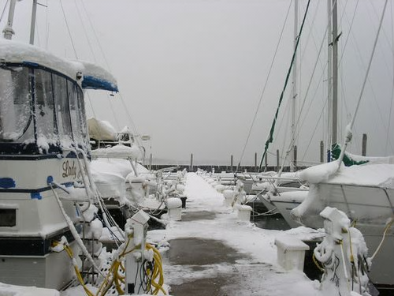


Winterization Overview
Northern Virginia Sail and Power Squadron
November 2012

Slide 2
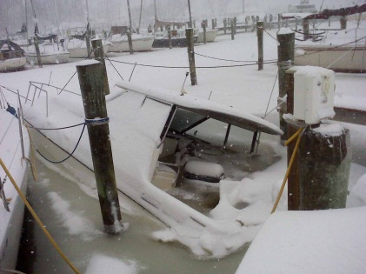
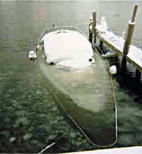
Why Winterize?
Your boat is a significant investment that needs to be protected
Prevention is always cheaper than repair
Virginia winters are capable of below zero temperatures for more than 72 hours
States with the most winter-caused losses
  California,
  Florida,
  Texas,

Slide 3

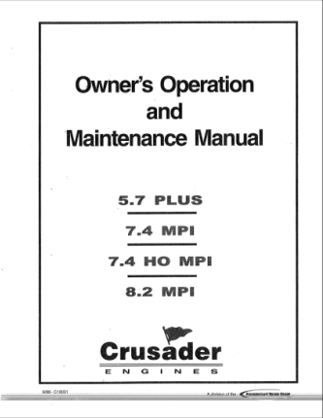
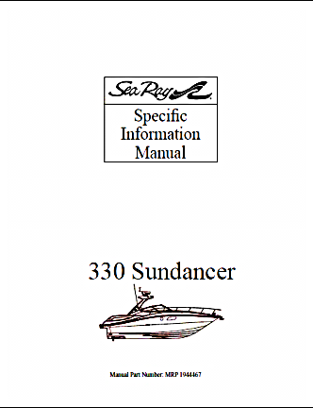
Getting Started
Review your boat’s manuals
  Manufacturer’s operations manuals
  Engine/Generator manuals
  Systems manuals
    Hull care and maintenance
    Mechanical systems
    Plumbing systems
    Air-conditioning systems
    Appliances
    Electrical/Electronics
Collect winterization and spring commissioning checklists
  Manufacturers (boat, engines, systems, etc.)
  Internet (boating articles, sample checklists, etc.)
  Marina service department
  Power Squadron members
  Boating friends

Slide 4
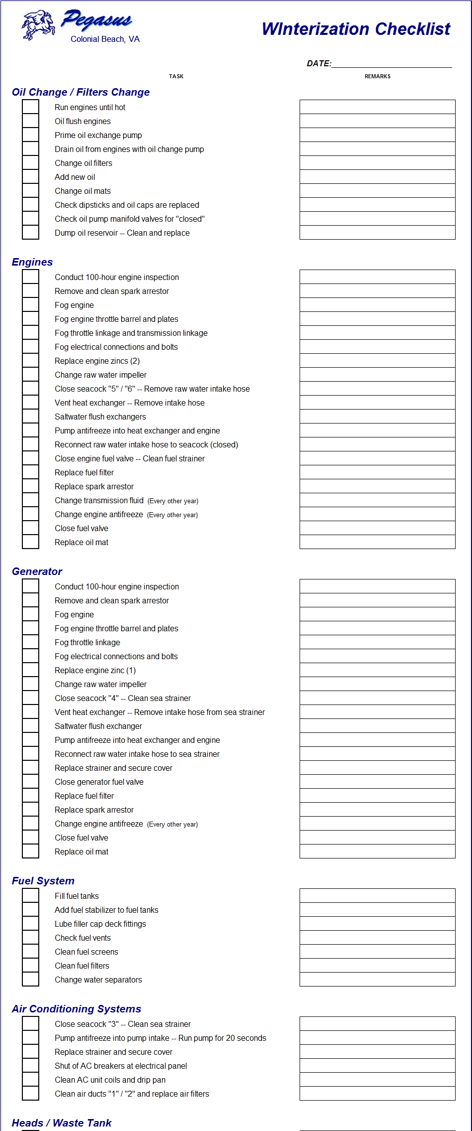
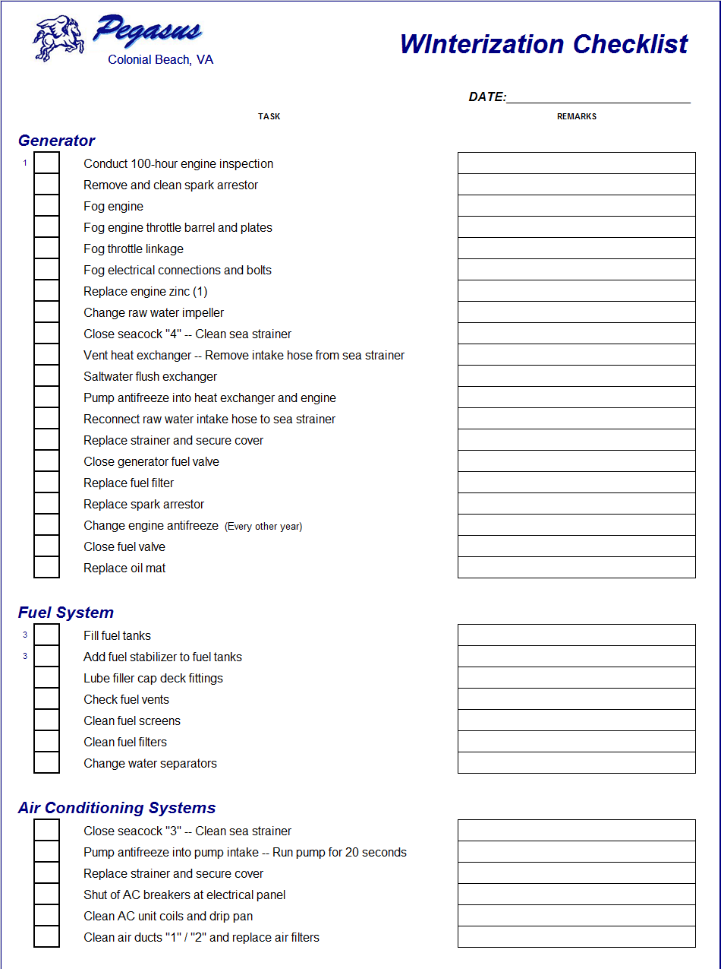
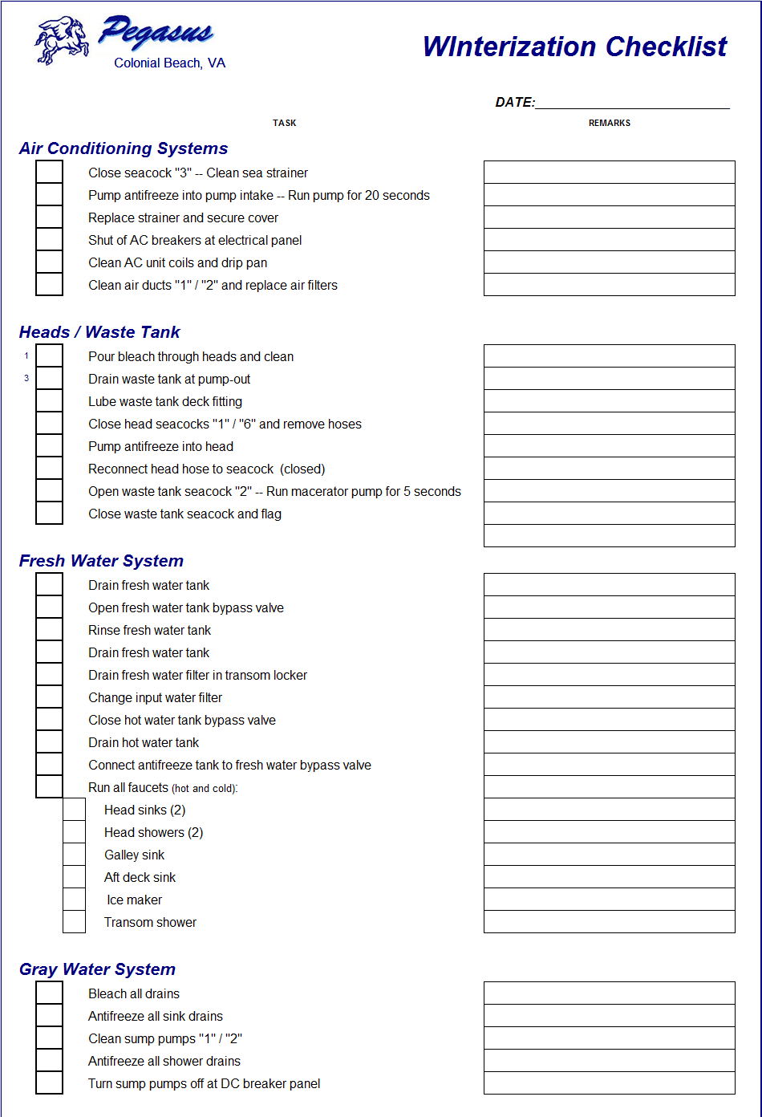
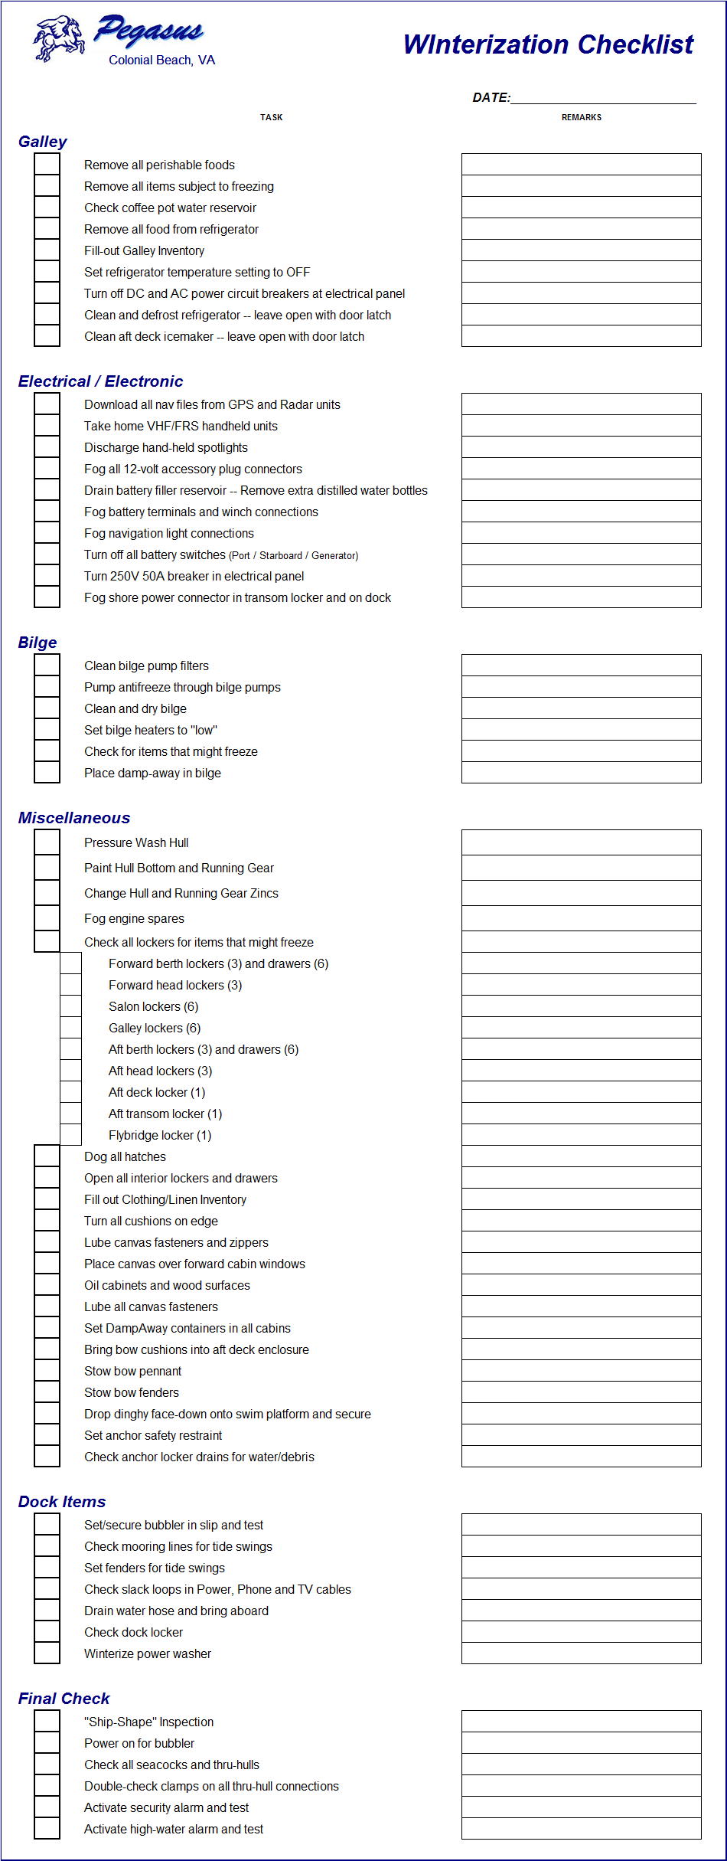
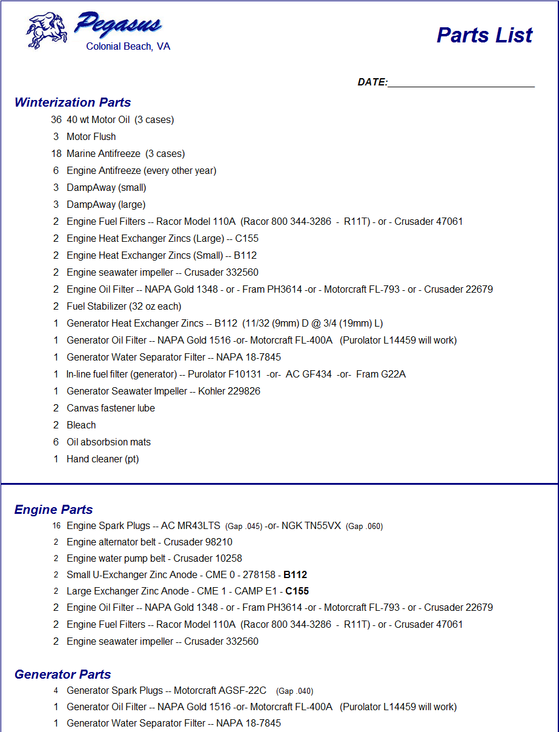
Getting Started (Continued)
Build your own checklist
  Specific to the needs of your boat
  Logical order of steps
  The more detailed the better
  Include sub-steps and/or notes
Create a list of supplies and parts you are going to need
    Engine oil / Lubricants
    Antifreeze
    Fogging oil
    Filters (fuel / oil / water / water separator)
    Impellers
    Zincs
    Fuel stabilizer / biocide
    Cleaning supplies / oil mats

Slide 5
Money Saving Tips
Buy fuel/oil filters, water separators, motor oil and miscellaneous supplies from a local auto parts store
Buy your boat winterizing supplies early (antifreeze, stabilizers, zincs, etc)
Use -50° antifreeze for all water systems, but use -100° antifreeze for the enhanced corrosion protection for the engines
Carefully remove and save your old impellers as spares

Slide 6
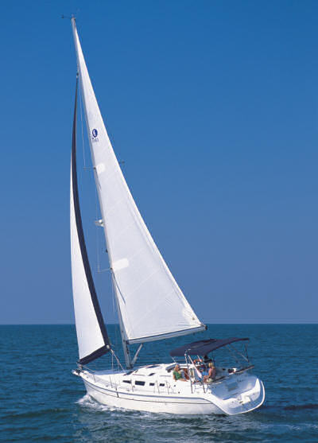
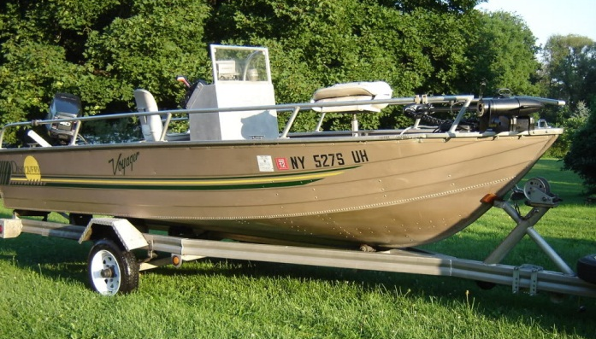
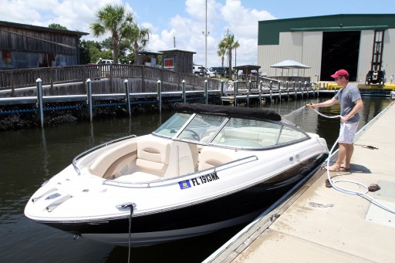
Types of Winterizing
Type of drive system
  Outboard
  Inboard / Outboard (I/O)
  Inboard
  Sail drive
  Jet drive
  Sail
Storage
  On land
  On water
  On the trailer
Other items
  Dinghy
  Trailer

Slide 7
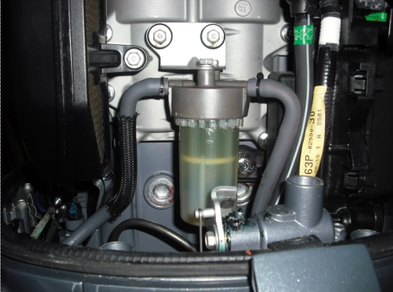
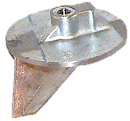
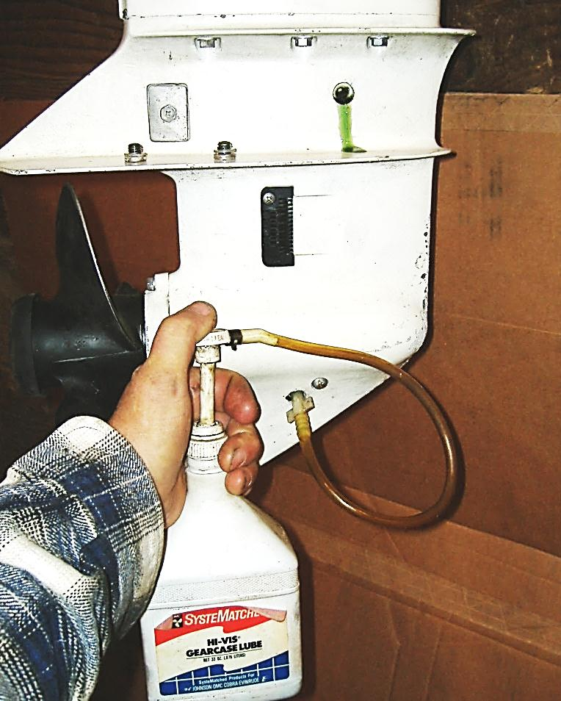
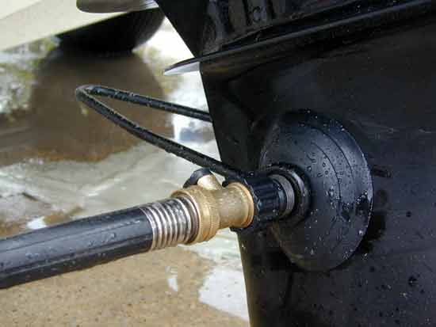
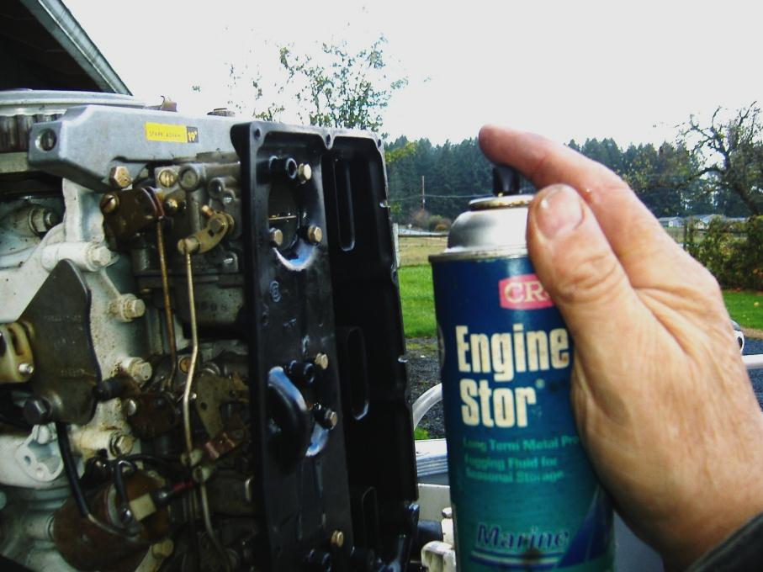
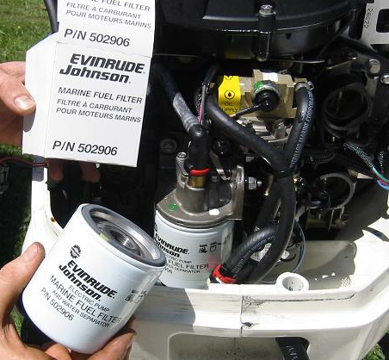
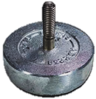
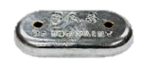
Outboard Motor Winterization
Conduct 100-hour engine inspection
  Rust and corrosion
  Wire chafing
Change fuel filter – Flush fuel lines and carburetor
Change oil and filter (4-stroke engines)
Change air filter (if equipped)
Flush engine block
Fog engine and mechanical linkages
(throttle linkage, shift cables)
Lubricate lower unit
Change engine / drive unit zincs

Slide 8
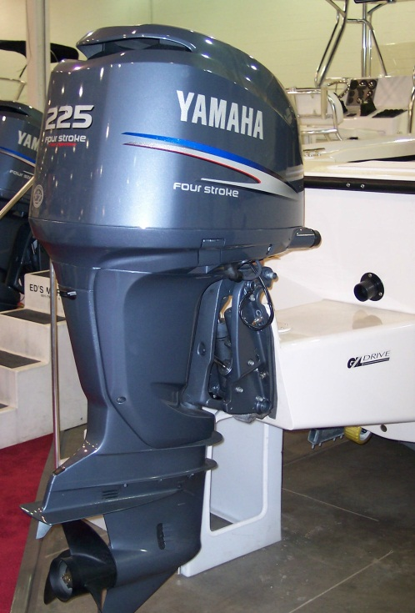
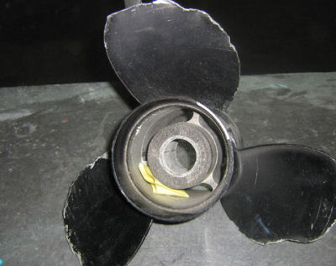
Outboard Engine Winterizing
Inspect U-joint bellows and bellow hose clamps for wear or weathering
Place drive in the DOWN position
Clear water drain holes in drive unit
  Pitot tube
  Trim cavity vent and cavity drain
  Gear housing water drain and cavity vent, and drain holes
Clean drive surfaces and repaint bare metal
Coat drive with a corrosion inhibitor
Inspect prop

Slide 9
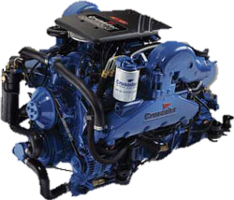
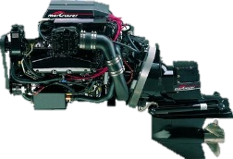
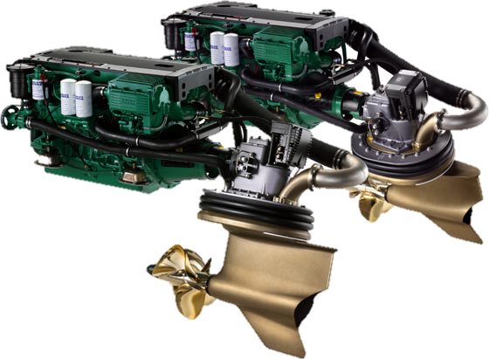
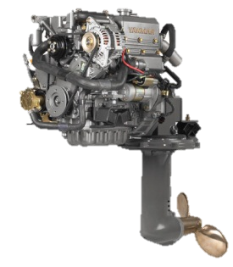
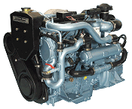
Engine Winterization
Conduct 100-hour engine inspection (per manufacturer’s spec)
  Rust and corrosion
  Worn belts/hoses
  Exhaust muffler and tubes
  Wire chafing
  Fuel system (Schrader valve, in-line screens/filters)
Engine servicing
  Oil and filter change
  Inspect/clean spark arrestor (if equipped)
  Fog engine and mechanical linkage (throttle, shift cables)
  Antifreeze heat exchanger or engine block
  Change engine zincs
  Seacocks / Sea strainers
  Biannual maintenance (as directed by manufacturer)
    Change raw water impeller
    Change transmission fluid
    Change engine antifreeze

Slide 10
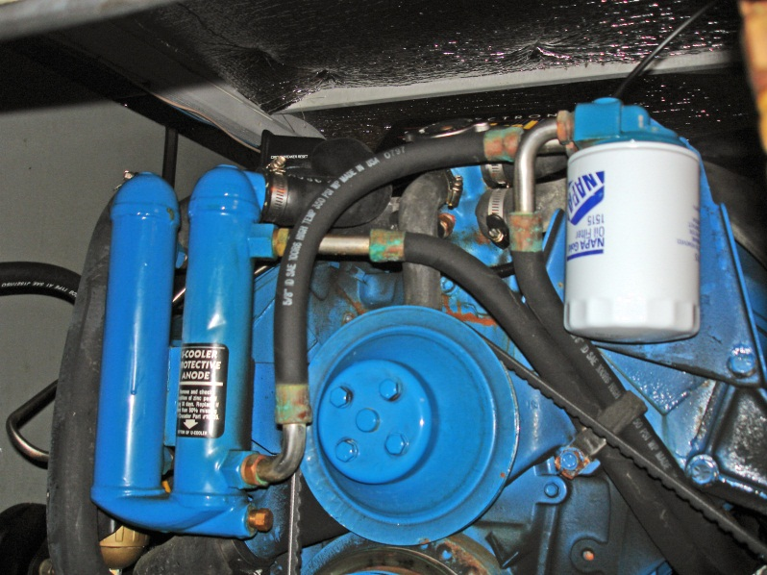
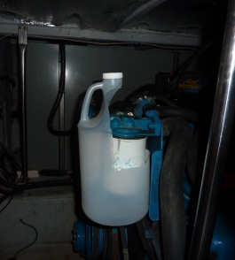
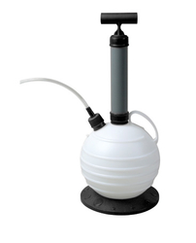
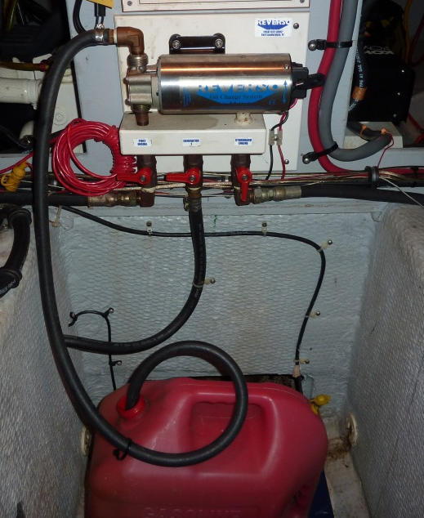
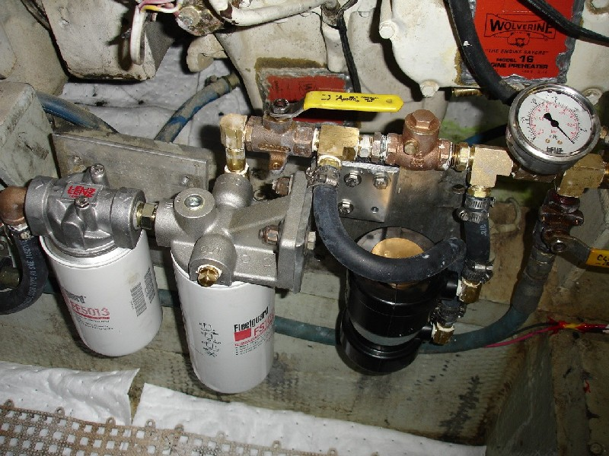
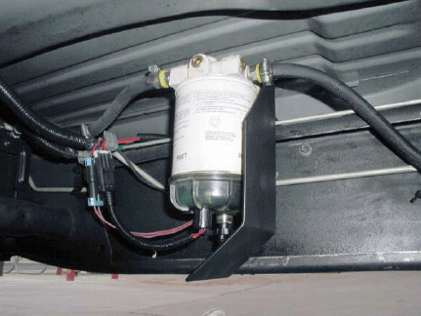
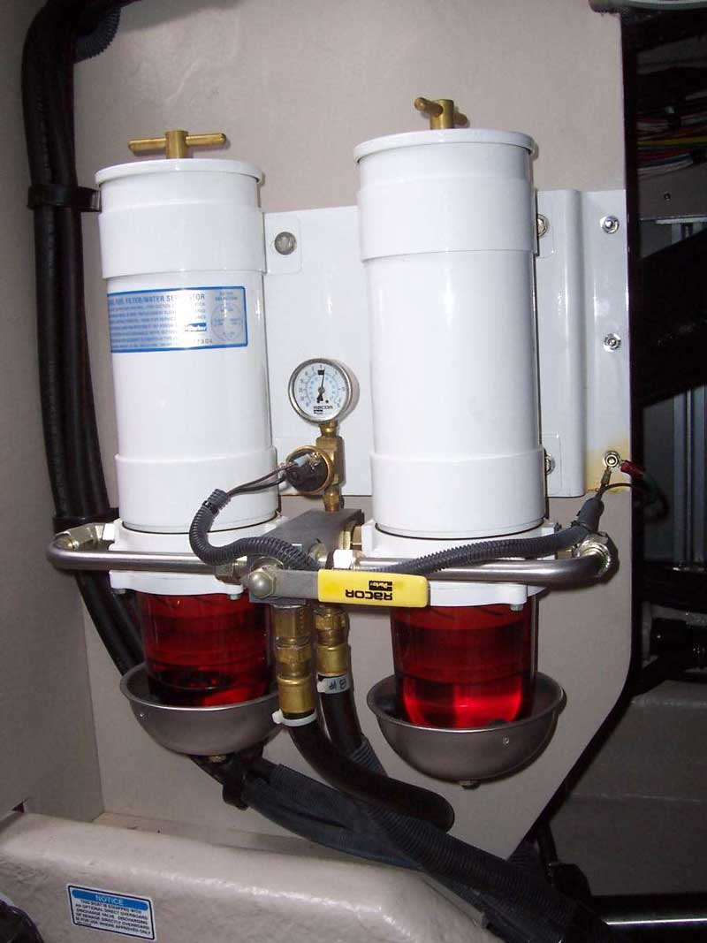
Oil / Filter Change
Old oil has contaminates that will act on engine components during the winter
  Check oil lines to the U-Cooler
  Tip: a plastic bottle can be used to keep oil from spilling into the bilge
Northern Virginia Sail & Power Squadron ®

Slide 11
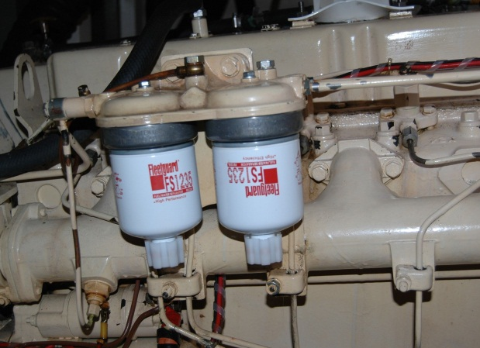
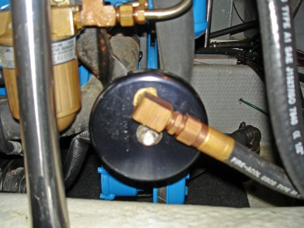
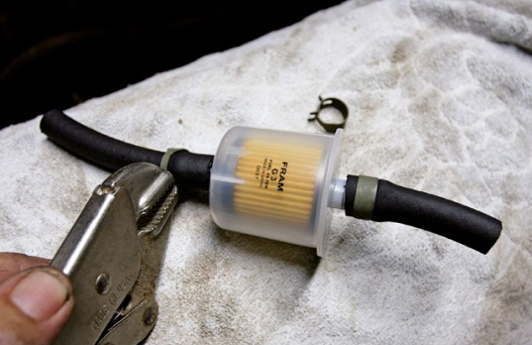
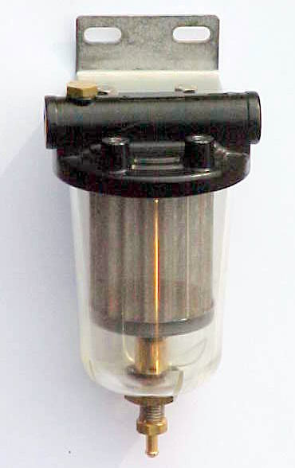
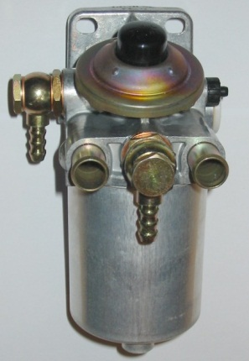
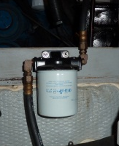
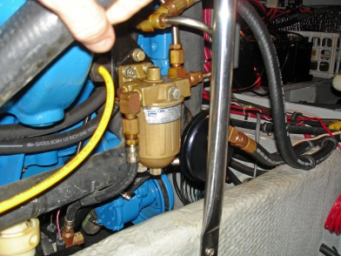
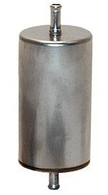
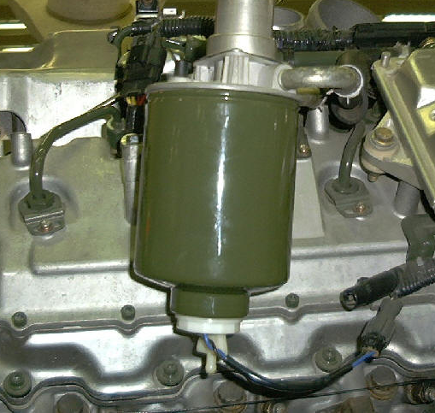
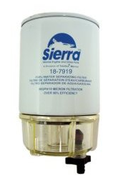
Fuel System
If you fill fuel tanks, add stabilizer
Lube filler cap deck fittings
Check fuel vents
Clean fuel tank filters
Change water separators
Close engine fuel valves -- Clean fuel strainer
Replace fuel filter

Slide 12
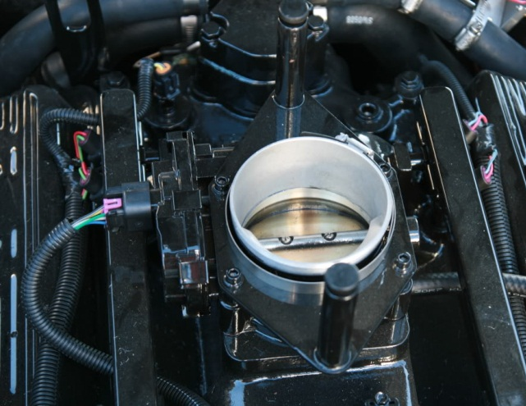
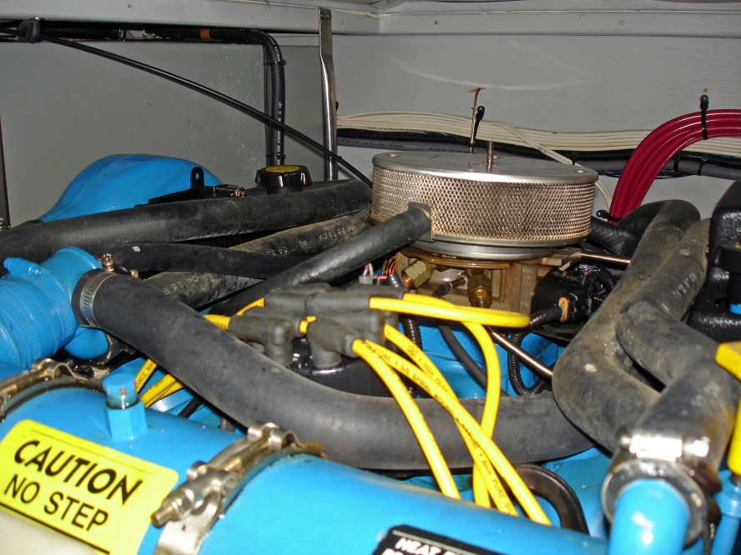
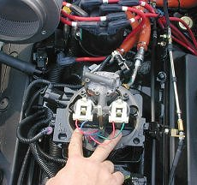
Engine Fogging
Clean and inspect Spark Arrester
Fog manifold/injector intakes and throttle/shift linkage

Slide 13
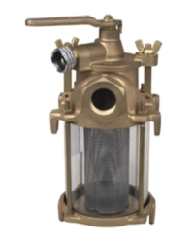
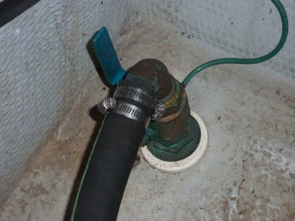



Sea Strainers and Sea Cocks
Sea strainers should be cleaned and filled with antifreeze
Sea cocks need to be closed
Flush valves make winterizing engines easier and more thorough

Slide 14



Stuffing Boxes and Dripless Shafts
Check stuffing box drip rate
  Make sure it is not dripping when stopped
  2-3 drop per minute when running is ideal
Check that dripless shafts are not dripping at all

Slide 15













Sacrificial Anodes (Zincs)
Engine zincs
  Exchange cooler
  Transmission/oil cooler
  Raw water intakes
Outdrive zincs
  Actuator piston arms
  Prop hubs
  Lower unit foot/skag
Running gear
  Prop shafts
  Rudders
  Trim tabs
Hull
  Grounding buss
  Near intakes and transponders

Slide 16



Air Conditioning Systems
Pump/draw antifreeze into air conditioner pump intake
Clean sea strainer and add antifreeze
Clean AC unit coils and drip pan
Clean air ducts and replace air filters
Shut of AC breakers at electrical panel

Slide 17




Heads / Waste Tank
Pour cleaning solution through heads and clean
Drain waste tank at pump-out
Lube waste tank deck fitting
Close head seacocks
Pump/draw antifreeze into head – run enough to fill the line to the waste water tank
Open waste tank seacock – Run macerator pump
Close waste tank seacock and remove handle or flag

Slide 18


Fresh Water System
Bypass valves
  Fresh water tank
  Hot water heater
Rinse and drain fresh water tank
Drain/replace fresh water filters
Drain hot water tank
Pump/draw antifreeze to all faucets
  Head sink
  Head shower
  Galley sink
  Aft deck sink
  Ice maker
  Transom shower

Slide 19
Bypass Valves
ANTIFREEZE
BUCKET
FILLER TUBE
TANK
BYPASS
LINE
WATER PUMP
ACCUMULATOR
CHECK VALVES
TANK VENT
IN-LINE FILTER
WATER TANK
WATER
HEATER
TANK BYPASS
COLD
HOT
TANK BYPASS
VALVE / DRAIN
SHORE WATER CONNECTION

Slide 20

Gray Water System
Bleach all drains
Antifreeze all sink/shower drains
Clean sump pumps – add antifreeze
Run antifreeze through anti-siphon loop
Turn sump pumps off at DC breaker panel
SINK
TRAP
Shower
Drain
ANTI-SIPHON
LOOP
SUMP
DISCHARGE
SUMP PUMP

Slide 21


Galley
Remove all perishable foods
Remove all unsealed food stores
Remove all items subject to freezing
Set refrigerator/ice maker temperature
setting to OFF
  Clean/defrost refrigerator/ice maker
  Prop door open
Drain appliance reservoirs or drip pans
  Coffee pot
  Refrigerator
  Ice maker
Close propane gas lines (tank/stove)
  Remove propane bottles from the boat.
  Seal the end of the propane line.
  Inspect propane lines for damage.

Slide 22
Sailboat
Sails and rigging
  Inspect sails for ware and damage
  Wash sails and running rigging; and store
Mast
  Pull the mast, inspect mast boot, mast heel and fittings for corrosion
  Check the crane and masthead sheaves for wear and stress cracks,
  Inspect electrical wiring to the navigation and spreader lights
  Inspect boom and rigging for wear and damage.
  Remove tape from spreader tips and turnbuckles and inspect
Systems
  Fog winches, mainsheet system, turning blocks and rope clutches
  Remove all the running rigging and wash – Run a mouse to retrieve in the spring
  Fog all exit boxes and turning blocks – inspect for wear and corrosion
  Lube folding prop and steering linkage

Slide 23
Electrical / Electronic
Download nav files from GPS and Radar units
Take VHF/FRS handheld units home
Discharge hand-held spotlights
Fog all 12-volt accessory plug connectors
Fog battery terminals and winch connections
Fog navigation light connections
Turn off all battery switches * (Port / Starboard / Generator)
Turn off AC breaker in electrical panel
Fog shore power connectors
* Make sure your bilge pumps and water alarms are still directly powered

Slide 24

Bilge
Clean bilge pump filters
Pump antifreeze through bilge pumps
Pump water out of bilge - Clean and dry bilge
Set bilge heaters to “low” (if not off)
Check for items that might freeze
Place damp-away in bilge

Slide 25
Miscellaneous
Make sure deck scuppers are clear and open
Seal deck hatches for water intrusion
Pressure Wash Hull
Paint Hull Bottom and Running Gear
Fog engine spares
Dog all hatches/portholes
Open all interior lockers and drawers
Turn all cushions on edge
Lube canvas fasteners and zippers

Slide 26
Miscellaneous (Continued)
Waterproof canvas
Set canvas supports/restraints
Oil cabinets and wood surfaces
Place DampAway in cabin spaces
Place bow/deck cushions in cabin
Set anchor safety restraint
Check anchor locker for water/debris
Check all lockers for items that might freeze

Slide 27

Storage
Water storage
  Better supported hull
  Concern for snow loading pushing thru-hull fittings below the water
  Water collecting in bilge through leaking deck hatches
Land storage
  Better assess for maintenance
  Boatel storage vs. open storage
  Winter storage boat covers needed
  Security concerns
On trailer
  Easier to store – less expensive
  Winter storage boat covers needed
  Security concerns

Slide 28

Shrink Wrap
Advantages
  Good tight, weatherproof seal
  Keeps topsides and interior clean
  No concerns with chafing or loose tarps
  Optional vents and zippered doors prevent
  mold and mildew
  Far superior to bimini or regular canvas covers
Disadvantages
  Cost runs $18 to $26 per foot – doors and vents are an extra expense
  Cannot reuse the cover
  Is not considered a particularly ‘green’ environmental solution
  Limits access to the boat throughout the winter
  Improperly vented cover and cause mildew problems
  Potential gelcoat damage from improper use of heat guns

Slide 29


Dock Items – Leaving Boat in the Water
Set/secure bubbler in slip and test
Check mooring lines for tide swings
Set fenders for tide swings
Check slack loops in Power/TV cables and water line
Drain water hose and bring aboard
Check dock locker for items that might freeze

Slide 30
Final Check – Leaving Boat in the Water
"Ship-Shape" Inspection
Power on for bubbler
Check all seacocks are closed
Inspect all thru-hulls fittings
Double-check clamps on all thru-hull connections
Activate security alarm and test
Activate high-water alarm and test

Slide 31
Trailer and Dinghy
Fog all electrical connections and lamp sockets
Lube winch and rollers
Lube ball hitch and safety latch
Fill hydraulic reservoir
Check for rust or corrosion
Set axel on blocks
Deflate dinghy and oil wood flooring

Slide 32
100 Years of Service
1914 - 2014

